Slide 1
Monte Carlo Simulation to Determine Equity Value of a Company
Pranav Thiriveedhi
CMDA 4984: Data Science for Quantitative Finance

Slide 2
Background
The equity value of a company is the full intrinsic value of a company based on the company’s shares and loans to the shareholders.
However, the value that analysts give to a company can detour pure mathematics and statistics that give an exact value for the company.
Other than exact stock price targets, there are a lot of random variables that are inputted into financial models, which make it difficult to retrieve a true intrinsic company value.

Slide 3



Equity Values
Below are the current (as of 04-25-2023) equity values for three very popular American corporations. I have selected three companies from different industries.
Apple Inc. (APPL) | Tesla Inc. (TSLA) | Goldman Sachs (GS)
Equity Value: $2,640,322,000,000 | Equity Value: $1,039,727,000,000 | Equity Value: $108,060,000,000
https://www.stock-analysis-on.net/

Slide 4
Data Used
After seeing these three companies, I will be reporting the Equity Value on Microsoft, using the Monte Carlo method:
Tesla Inc. (TSLA)
Equity Value: $2,153,016,000,000
A free source for pulling financial data is Yahoo Finance, so I will be using the yahoo_fin python library. I will also be using the Financial Modeling Prep site as it includes calculations for certain input variables that I would need to use to power my simulations.
https://site.financialmodelingprep.com/weighted-average-cost-of-capital/MSFT

Slide 5
Input Variables
As mentioned in the previous slide, to perform the calculations needed to find the equity value of a company, I need certain input variables.
Using certain random variables, we can find the true market of a company.
Of the many variables and points of data that affect any aspect of a company on a trading sheet, the four variables that I will select to compute the firm’s true value are the:
Revenue Compound Annual Growth Rate (CAGR)
The Marginal Earnings Before Interest and Taxes (EBIT)
The Weighted Average Cost of Capital (WACC)
The long-term growth rate of a company.

Slide 6
Monte Carlo Simulation
The idea of using the Monte Carlo simulation for this project is the method I am choosing to find the equity value of a company.
This is because I would be taking random variables to find the true valuation value, and the monte carlo algorithm takes random variable samplings and simulates them to obtain numerical values.
It models different ranges of values based on those random variables. So basically I would be getting ranges back for the equity value and compare those to the values that analysts have created online.

Slide 7
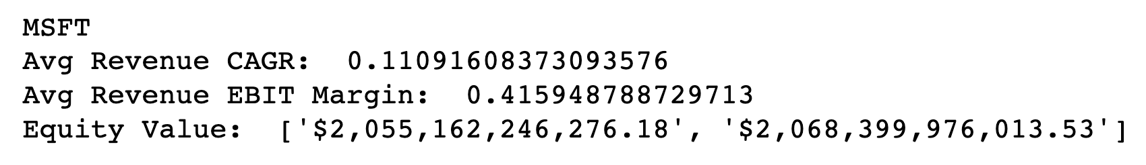
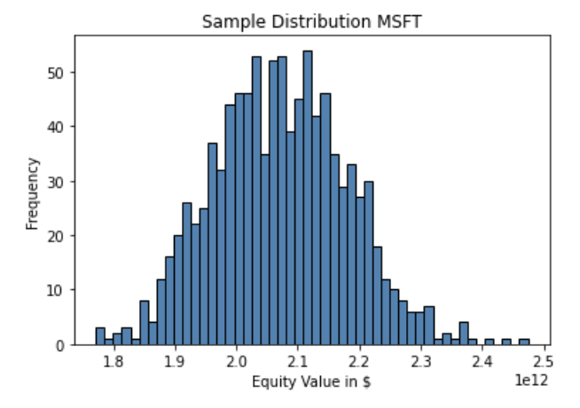
Preliminary Results
After going through iterations of my code, I have developed a range of possible equity values for Microsoft.
The bounds are listed to the right:
The equity value, written by analysts for Microsoft is:
$2,153,016,000,000
According to the bounds and sample distribution, it is very clear that the equity value that was outputted is very close to the value put out by analysts.

Slide 8
Motivation / Impact
Equity valuation of a company helps determine the fair market value for that company, which is vital in the whole stock market.
This is because the market is just a cycle of cash flow and putting more money in one basket than needed can upset the flow of cash and cause problems to arise.
The whole system of stock markets is based upon the idea of equity valuation.
The stock markets have a wide variety of stocks to offer to investors, where those perceived market values change every minute because of the change in information that the market receives on a real time basis.
Equity valuation therefore is the backbone of the modern financial system.
It allows businesses with strong business models and financials to command a higher value in the market.
On the other hand, it ensures that companies whose financials and models are weak to have a drop in their valuation.

